Slide 1
DM TA Session 7
Hanwen Serena Xu
hanwen@uchicago.edu

Slide 2
Contents
Association Rule
Recommendation System

Slide 3
Associate Rule Mining
Applications
Market Basket Analysis
Cross Marketing: is to work with other businesses that complement your own, not competitors
Catalog design - the selection of items in a business’ catalog are often designed to complement each other so that buying one item will lead to buying of another.
Medical diagnosis, census data, etc.
Notes:
- is to analyze the association of purchased items in a single basket or single purchase.
-. For example, vehicle dealerships and manufacturers have cross marketing campaigns with oil and gas companies for obvious reasons.
So, these items are often complementing or very related.

Slide 4
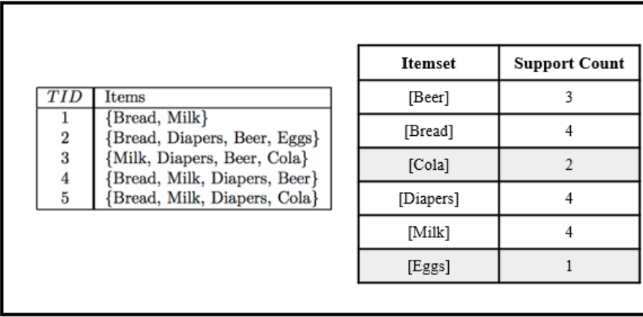
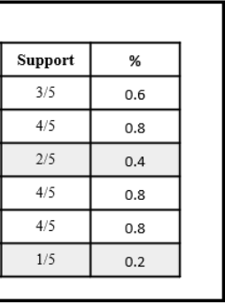
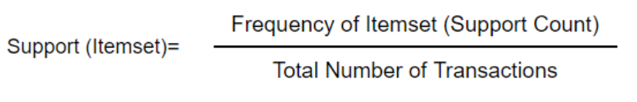
Apriori Algorithm
It works on the principle that “Having prior knowledge of frequent item sets can generate strong association rules.” The word Apriori means prior knowledge.
We consider len(itemset)=1 here.

Slide 5
Apriori Algorithm
Defining support as percentage helps us set a threshold for frequency called min_support. If we set support at 50%, this means that we define a frequent itemset as one that occurs at least 50 times in 100 transactions.
We always eliminate those items whose support is less than min_support as is seen from the greyed-out parts of the table above.

Slide 6
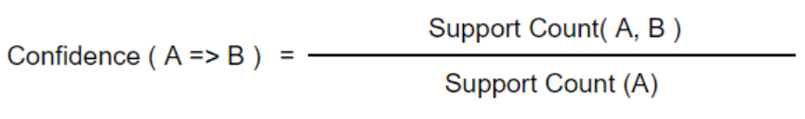
Apriori Algorithm
Confidence
helps identify which product drives the sale of which other product.
A drives B represented as {A ⇒ B} is not the same as B drives A, {B ⇒ A}
If the confidence of an association rule {A⇒B} is 60%, it means that 60% of the transactions containing A also contain B together.
Lift
Lift (A=>B) = Confidence (A=>B)
Support (B)
<1 : two products are unlikely to be bought together
=1 : there is no association between products A and B
>1 : products A and B are more likely to be bought together

Slide 7
Drawbacks of Apriori Algorithm
It is computationally intensive.
Apriori requires repeated scans of the database for itemset generation. This is very resource-intensive and time-consuming.
It can mine misleading patterns.
Apriori and other Association Rule Mining algorithms are known to produce rules that are a product of chance.
https://www.youtube.com/watch?v=g9c66TUylZ4
Notes:
For instance, in monsoon, the sales of umbrellas are likely to rise. Suppose a store places umbrellas near the cashier. people notice this when they’re billing the groceries and pick up an umbrella as well. This is likely to produce a rule that some grocery product drives the sales of umbrellas. This is in fact not true because the umbrellas were a one-time seasonal purchase

Slide 8
Recommendation System
The construction of systems that support users in their (online) decision making is the main goal of the field of recommender systems
In particular, the goal of recommender systems is to provide easily accessible, high-quality recommendations for a large user community
They are everywhere: Amazon, Neflix, Google, etc
Basic idea - if users shared the same interests in the past – if they viewed or bought the same books, for instance – they will also have similar tastes in the future
So, if, for example, user A and user B have a purchase history that overlaps strongly and user A has recently bought a book that B has not yet seen, the basic rationale is to propose this book also to B
https://www.youtube.com/watch?v=g9c66TUylZ4

Slide 9
Types of Recommender Systems
Collaborative Filtering:
Memory based
Item Based
User based
Model based
Content Based Recommending:
Hybrid Approach

Slide 10
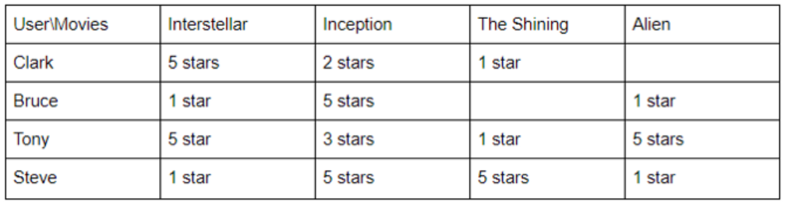
Collaborative Filtering
Based solely on the past interactions recorded between users and items in order to produce new recommendations. These interactions are stored in the so-called “user-item interactions matrix”.

Slide 11
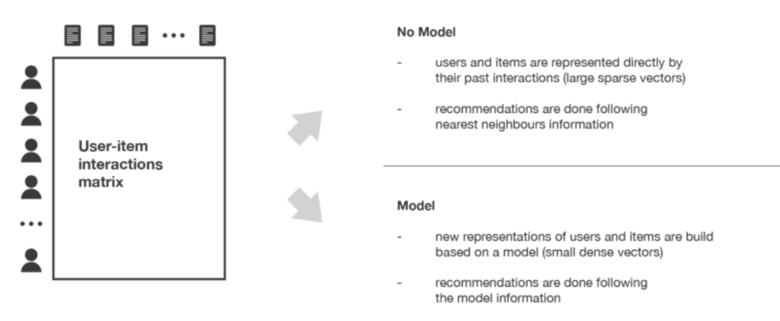
CF
Implicit ratings are knowingly/unknowingly interaction made by the user to a product for eg: No. of clicks, Time spent on a page, Bounce rate etc. Whereas explicit ratings are the ratings which are directly provided by the user like, reviews, ratings, feedback, likes, following etc.

Slide 12
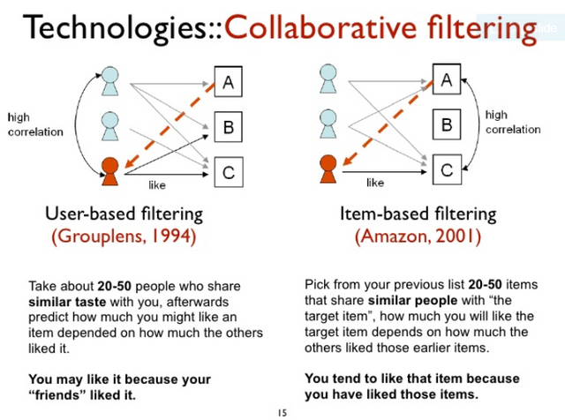
Item-based CF
Product similarity is particularly useful when we do not know much about the user yet, but we do know what products they're viewing.
It suffers from new product not been recommended.

Slide 13
Item-based CF
Pros
Properties of items/products do not change over time. They will remain same.
Item based do not require any history of user to recommend items it just need to properties of items which is already present and the user’s preference. Thus, often do not suffer from “Cold-start”.
Netflix, for example, avoids this issue by asking users their likes when starting a new subscription.

Slide 14
Model-based CF (Clustering)
In this strategy, similar users are clustered into segments and the similarity between the target user and a user segment is calculated
For each segment, an aggregate profile, consisting of the average rating for each item in the segment is computed and predictions are made using the aggregate profile rather than individual profiles
To make a recommendation for a target user u and target item i, a neighbourhood of user segments that have a rating for i and whose aggregate profile is most similar to u is chosen

Slide 15
Challenges of CF
Totally new users (cold start)
Outliers (grey sheep)
"Grey Sheep" users is a group of the users who have special tastes, and they may neither agree nor disagree with most of the users.
Manipulations with reviews
Data sparsity

Slide 16
Questions?

Slide 17
Recommended sources
Hands-On Machine Learning with R (Boehmke & Greenwell)
Hands-On Machine Learning with Scikit-Learn, Keras, and TensorFlow: Concepts, Tools, and Techniques to Build Intelligent Systems (Geron)
Applied Predictive Modeling (Johnson & Kuhn)
An Introduction to Statistical Learning: With Applications in R (James et al.)
Business Data Science: Combining Machine Learning and Economics to Optimize, Automate, and Accelerate Business Decisions (Taddy)
The Hundred-Page Machine Learning Book (Burkov)

